Slide 1
Role of World Radiocommunications Conference and European preparations for WRC
Stella Lyubchenko
4th CEPT Workshop on European Spectrum Management and Numbering
5th April 2016

Slide 2
Scope
WRC and its role for European countries
CEPT CPG role in the WRC preparation process
CPM Report structure
Overview of WRC-19 Agenda
EU related activities (RSPG)

Slide 3
World Radiocommunication Conferences (WRC)
WRCs are held every three to four years. WRC is reviewing, and, if necessary, revising the Radio Regulation (RR), the international treaty governing the use of the radio-frequency spectrum and the geostationary-satellite and non-geostationary-satellite orbits. Revisions of RR are made on the basis of an Agenda approved by ITU Council. Agenda for the following WRC takes into account recommendations made by previous WRC.
Radio Regulations
The Radio Regulations incorporates the decisions of the WRCs including all Appendices, Resolutions, Recommendations and ITU-R Recommendations incorporated by reference.
WRC decides on a high level international framework which is afterwards implemented on a regional basis in all five regional organisations.

Slide 4
WRC-19
Radiocommuncation Assembly +
World Radiocommunication Conference
2015
CEPT preparation for WRC - CPG
Res. ITU-R 4-7
WRC Agenda
Res. ITU-R 2-7
1st CPM
session
Establishment of CPG PTs - allocation of the work
ITU-R Study Groups
SG1 Spectrum management
SG3 Radiowave propagation
SG4 Satellite Services
SG5 Terrestrial Services
SG6 Broadcasting Services
SG7 Science Services
Draft CPM Report to WRC
CPG/CPG PTs contributions to ITU-R work / development of ECC views
2st CPM
session
CPM Report to
WRC
Final CEPT Positions – CEPT Briefs / European Common Proposals (ECPs)
Contribution from membership
WRC
ECP
Proposals from Member States
2019

Slide 5
Main Steps towards WRC-19
WRC-15: WRC-19 Agenda - Resolution 809 (WRC-15)
1st Session Conference Preparatory Meeting CPM19-1: 30 Nov. – 1 Dec. 2015; Results @CA/226 of 23.12.15
Council (May 2016): Finalise WRC-19 Agenda
2nd Session Conference Preparatory Meeting CPM19-2 [Dates t.b.d. for the final CPM Report to be available six months prior to WRC-19]
Final meetings of regional groups
→ Member States proposals to WRC-19

Slide 6
Conference Preparatory Group
CPG role within CEPT
Charmanship of CPG
CEPT partners in another regions (APT, ASMG, CITEL, ATU, RCC)
ECO acting as a permanent point of contact between ECC/CPG and other regional organisations

Slide 7
CPG main role and deliverables
Prepares European positions for ITU World Radiocommunication Conferences (WRCs) and Radiocommunication Assemblies (RAs)
Develops common positions in respect of ITU-R meetings, in particular for the Conference Preparatory Meeting (CPM) (to prepare WRCs)
Develop and agree European Common Proposals (ECPs) for the work of WRCs and RAs
Prepare and approve Briefs (position documents) to present the European positions at WRCs and RAs

Slide 8
CPG19 structure and organisation
CPG19 will held its first meeting in Bonn, Germany (12 – 14 April 2016) in order to:
appoint CPG vice-chairman, PTs chairman and CEPT Coordinators
define PTs responsible for various WRC-2019 Agenda Items
further information will be made available: http://cept.org/ecc/groups/ecc/cpg

Slide 9
ECO support to CEPT during the WRC-15
Weekly reports from WRC-15 at Conference Preparatory Group page: http://www.cept.org/ecc/groups/ecc/cpg
Detailed information on the most important for CEPT issues
CEPT sms/messaging/chat system for WRC-15 coordination process

Slide 10
Chapters of the draft CPM Report to WRC-19
Chapter 1: Land mobile and fixed services
Chapter 2: Broadband applications in the mobile service
Chapter 3: Satellite services
Chapter 4: Science services
Chapter 5: Maritime, aeronautical and amateur services
Chapter 6: General issues

Slide 11
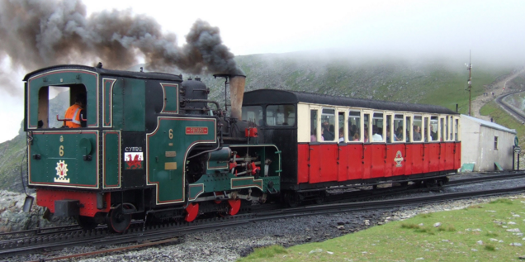
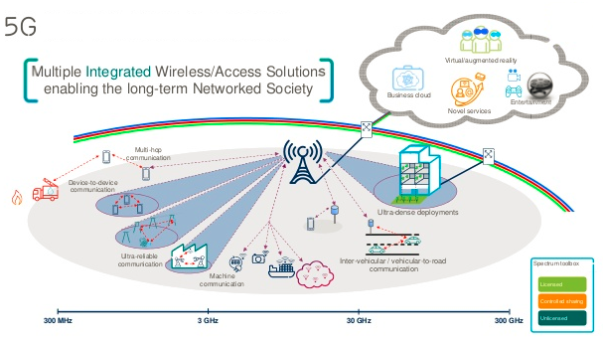
WRC-19 Agenda from CEPT prospective
Land mobile and fixed services:
railway studies between train and trackside, intelligent transportation systems,
identification for land mobile and fixed service applications in 275-450 GHz
Broadband applications in the mobile service:
IMT above 6 GHz issue (regarded as 5G) focussing on specific frequency bands not including bands around 6-20 GHz and 27.5-29.5 GHz,
mitigation techniques for RLAN in the frequency range between 5 150 MHz and 5 925 MHz.

Slide 12
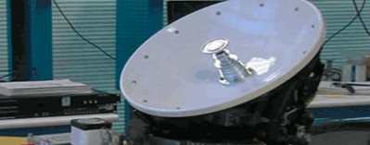
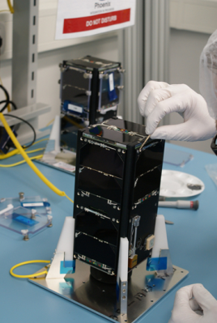
WRC-19 Agenda from CEPT prospective
Satellite services:
ESIM (earth stations in motion communicating with geostationary space stations in the FSS) in the bands 17.7‑19.7 GHz (space-to-Earth) and 27.5-29.5 GHz (Earth-to-space).
Science services:
Meterological Satellite service allocation at 460-470 MHz,
Frequency requirements for the ‘short duration missions’ (nano-pico satellites).
Maritime, aeronautical and amateur services:
Modernisation of Global Aeronautical Distress and Safety System (GADSS),
International regulations for maritime radio devices.
The total number of proposed substantial agenda items for WRC-19 is 16.

Slide 13
EU related activities (RSPG)
Identify areas of common European interests in forthcoming WRC-19 agenda in order to present policy objectives to the Council and the European Parliament.
Assist the European Parliament, the EU Council and the European Commission in formulating Common Policy Objectives
Enable the European Commission and the other European institutions to offer guidance to member states in developing ECPs and to ensure coordination between EU and non-EU countries

Slide 14
Useful links
CPG home page (http://www.cept.org/ecc/groups/ecc/cpg)
Draft Agenda for WRC-19
List of CEPT Coordinators
List of CPG deliverables

Slide 15
THANKS FOR YOUR ATTENTION
Stella.Lyubchenko@eco.cept.org

